Slide 1

Engagement Report Engagement Survey
Sogo
September 2018 - September 2028

Slide 2
Project Overview
Engagement is the connection that individuals have with their profession in general, and their current jobs in particular. Many factors may impact an engagement, including quality of communication, clarity of purpose and direction, career growth and training opportunities, work environment, and feedback and recognition.
This Engagement survey had three goals:
Measure the level of engagement among Engagement Report.
Classify Engagement Report as highly engaged, engaged, or less engaged.
Identify areas where Engagement Report engagement can be improved.
This survey was open from September 2018 to September 2028.
This report provides an organization-level overview of the survey results.
*

Slide 3
Understanding Results
Responses to the items were averaged to find an engagement score for each respondent.
The five response options were: Strongly Disagree, Disagree, Neither Disagree nor Agree, Agree, and Strongly Agree. To calculate the engagement score, each response option was given a weight, ranging from 1 (Strongly Disagree) to 5 (Strongly Agree).
Results do not reflect random sampling; therefore, they should not be generalized to all respondent. Rather, results reflect only the perceptions and opinions of survey participants.
Findings for each item in the report exclude participants who did not answer. Data labels less than 5 percent are not shown in charts and graphs. Percentages may not add up to 100 because of rounding.
*

Slide 4
Study Design
The Engagement Survey consists of three parts:
Overall Engagement is composed of items that are designed to measure each participant’s level of engagement. Based on the average
of the responses to these items, an engagement score is calculated for each survey participant. Engagement scores are classified as less engaged (<3.5), engaged (3.5 to 4.5) or highly engaged (>4.5).
Engagement Drivers are items about different aspects of the work environment that may affect engagement. Participants answered each item using the 5-point Likert scale. Engagement drivers are organized into six dimensions:
Shared values
Leadership
Communication
Feedback and recognition
Work environment
Career growth and training opportunities
Demographic Questions provide information about participants, such as location and job classification.
*

Slide 5
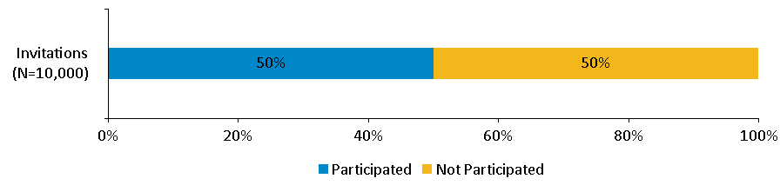
Response Rate
Response Rate = 50%
*

Slide 6
Overall Engagement

Slide 7
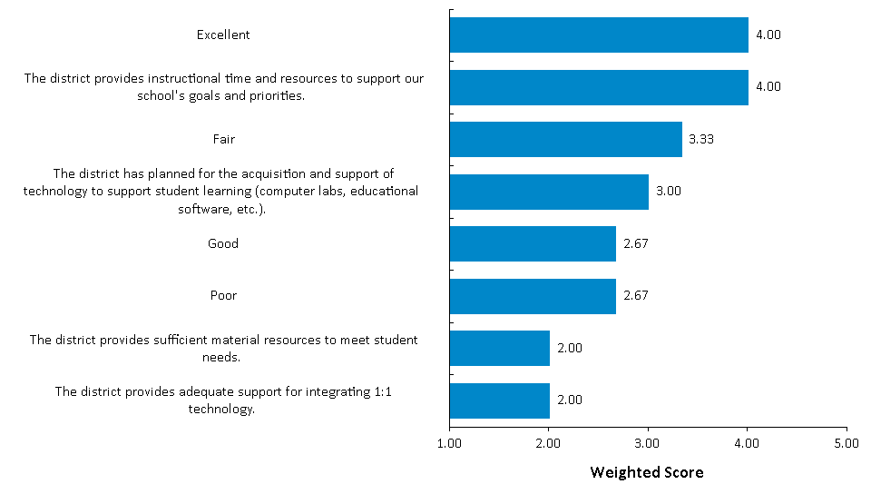
Overall Engagement
Engagement Scale Items

Slide 8
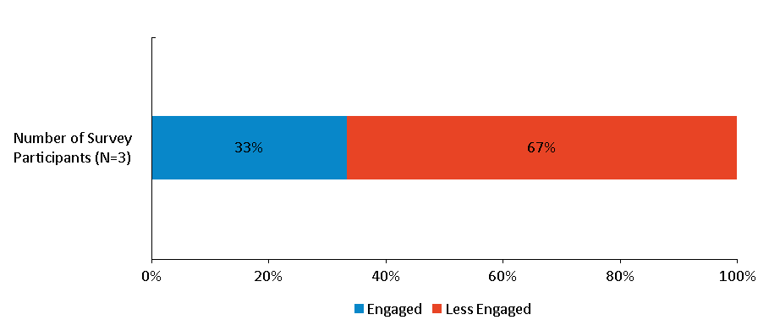
Overall Engagement
Overall Level of Engagement

Slide 9
Focus Areas

Slide 10
Focus Areas to Improve Engagement
Multiple drivers were used to assess the workplace environment and identify opportunities to increase engagement. Each item was rated on a five-point scale, with higher values indicating stronger agreement.
The relationship between each responses (driver ratings) and his or her overall engagement score was also analyzed. To do this, the strength of the relationship (the correlation coefficient) between the engagement scores and each driver was calculated. Values can range from -1.0 to +1.0. The closer to +/-1.0, the stronger the relationship.
Driver ratings were classified as high or low based on the median. Correlations to engagement were classified as strong or weak based on the median.
The primary focus area (red) is for Items that rated low but have a strong correlation to engagement. The secondary focus area (yellow) is for items that received high ratings and have a strong correlation to engagement.
Correlation To Engagement
 |  | Strong | Weak
Driver Rating | Low | Primary Focus
 | High | Secondary Focus
*

Slide 11
Where Should Efforts be Focused to Improve Engagement?
 | Survey Item | Driver Rating | Correlation to Engagement
 | In our school, related learning support services are provided for all students based on their needs. | 0.60 | -1.00
Correlation To Engagement
 |  | Strong | Weak
Driver Rating | Low | Primary Focus
 | High | Secondary Focus
Median
Driver Rating | 2.69
Correlation To Engagement | -1.00
*

Slide 12
Where Should Efforts be Focused to Improve Engagement?
 | Survey Item | Driver Rating | Correlation to Engagement
 | Food services | 2.54 | NA
 | Administrative support staff, such as clerical | 2.59 | NA
 | Teacher | 2.61 | NA
 | Facilities and operations support staff | 2.78 | NA
 | Paraprofessional | 3.04 | NA
 | Psychologist, social worker, speech pathologist or other auxiliary certified staff | 3.11 | NA
 | Guidance counselor, media specialist, or other certified instructional specialist | 3.27 | NA
Correlation To Engagement
 |  | Strong | Weak
Driver Rating | Low | Primary Focus
 | High | Secondary Focus
Median
Driver Rating | 2.69
Correlation To Engagement | -1.00
*

